Slide 1
Standards Balloting and
Commenting System (SBS)
Login, Registration, Validation, and Permissions
January 2015

Slide 2

Register/Request Additional Permissions
Voter and Proxy

Slide 3
What is the ERO Platform?
Container for services shared amongst the ERO Enterprise line of business applications
  BESnet
  SBS
Authentication is the current service provided
  Validation of registrant’s account information

Slide 4
Who Needs an ERO Platform Account?
Role | ERO Platform Account Required | Additional Permissions Required?
Guest/ Anonymous User | No | No
Contributor | Yes | No
Proxy | Yes | Yes
Voter | Yes | Yes
Roles and Permissions
Certain roles require an ERO Platform account along with requesting additional permissions to perform Standards Balloting activities.
Guest: view/read only access to SBS Dashboard links
Contributor: individual who can comment on proposed Standards
Proxy: individual authorized to cast a vote on behalf of the RBB Member and comment on proposed Standards
Voter: Registered voting member of the NERC Registered Ballot Body for the purpose of casting votes and commenting on proposed Standards
Notes:
Speaker Notes: Ensure individuals know what SBS (Standards Balloting System) and RBB (Registered Ballot Body) mean during the discussion

Slide 5
Additional Information
Role | ERO Platform Account Required | Additional Permissions Required?
Contributor | Yes | No
Proxy | Yes | Yes
Voter | Yes | Yes
Roles and Permissions
Once you have registered for the role of Contributor you can begin to comment via ‘Take Survey’ and use the ‘Social Survey’ tool.
Once you have the role of Contributor, you can register to become a Voter or Proxy. You will be able to comment via ‘Take Survey’ and use the ‘Social Survey’ tool while your RBB request is being vetted by NERC staff.
Notes:
Speaker Notes: Ensure individuals know what SBS (Standards Balloting System) and RBB (Registered Ballot Body) mean during the discussion

Slide 6
Accessing SBS
SBS URL - https://sbs.nerc.net/
Balloting and Commenting Page
  Casting a vote and commenting in the new SBS:
  All current NERC Registered Ballot Body (RBB) members must go through a new registration process. If you have not registered or are a new member requesting membership in the SBS, please click here. Please access the Standards Balloting and Commenting System Tutorial for instructions or the Frequently Asked Questions document for assistance.

Slide 7
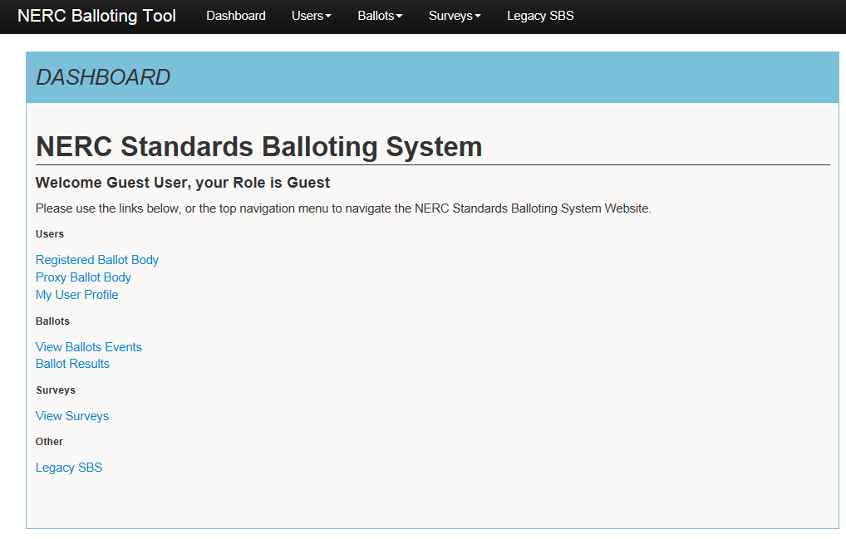


Login/Register
Guest User Dashboard:
Registering for an ERO Platform Account
From the Standards Balloting System Dashboard, use the link in the upper right-hand corner of the top navigation to create a new ERO Platform account.
If you already have an existing ERO Platform account use your credentials to login.
    Create an account first and login to request additional permissions to perform Standards Balloting activities.
Notes:
Speaker Notes:

Slide 8
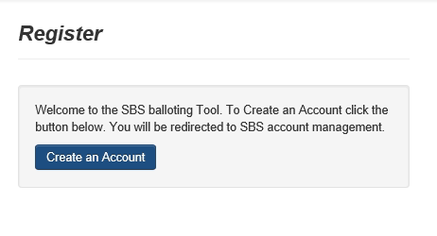
Create an Account
Register to Create an Account
Select Create an Account to request additional permissions to perform Standards Balloting activities.

Slide 9
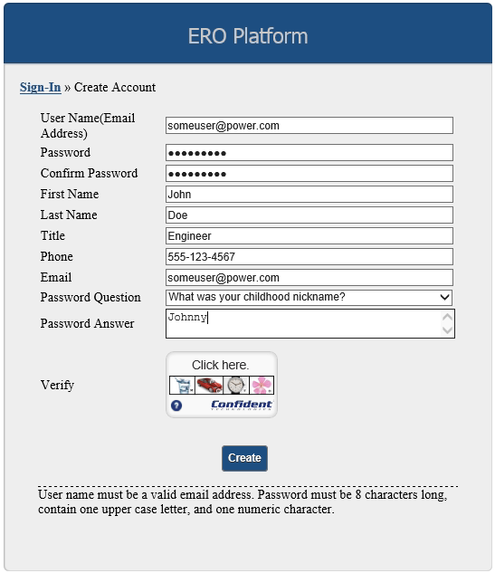
Create an Account
Create an ERO Platform Account
Complete all of the required fields*
  *User Name – enter valid business email
  address
  *Password – password must be 8
  characters long, contain one upper case
  letter, and one numeric character.
  *Confirm Password – re-enter password
  *First Name – enter first name
  *Last Name – enter last name
  *Title (Optional) – enter title
  *Phone – enter phone number
  *Email – enter valid business email address
  *Password Question – select a security
  question
  *Password Answer – enter password
  answer
Notes:
Speaker Notes: All fields are required when creating a new user account. If any fields are omitted, you will get an error message and will not be allowed to proceed.

Slide 10
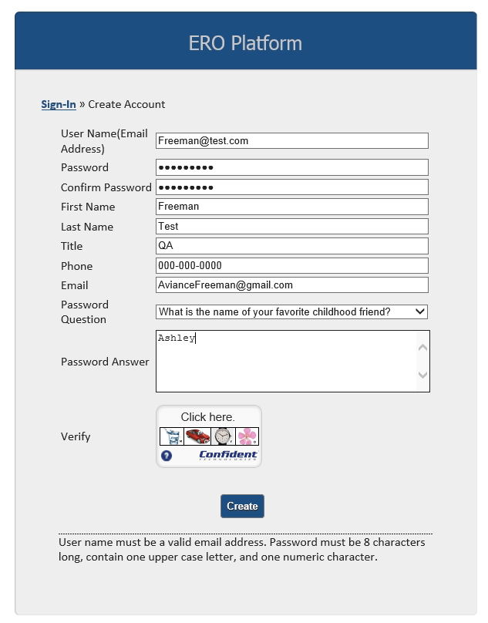
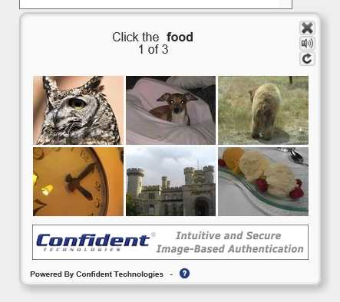
Verify Account – Part I
Verify Account – Part I
SELECT the Verify icon, several images display. SELECT the correct image of each description as instructed until all three pictures have been verified.
Upon successful verification, SELECT Create to create your account.
2
1
Notes:
Speaker Note: Final phase of creating an account you will have to complete the additional security layer that has been added to the system. Once you select the verify icon, you will have several images to choose from in the icon box. The system will direct you to identify three objects in order based on specific questions pertaining to the pictures. Once you have completed three of the identifications successfully, we will now be able to select the activated “create” button.

Slide 11
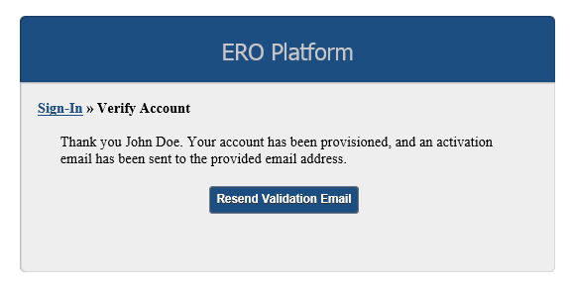


Verify Account – Part II
Verify Account – Part II
Upon successful verification, a verification email will be sent to the email account used to create your user account. Upon verification you will be able to access your account with preliminary permissions.
IMPORTANT: The activation email provided for validation expires after 10 minutes if not used.
If expired, SELECT the Resend Validation Email to have the activation email sent to the email address provided.
Notes:
Speaker Note: Stress the 10 minutes security feature. Most passwords will remain active for much longer so the individual understands the urgency of activating the account immediately.

Slide 12
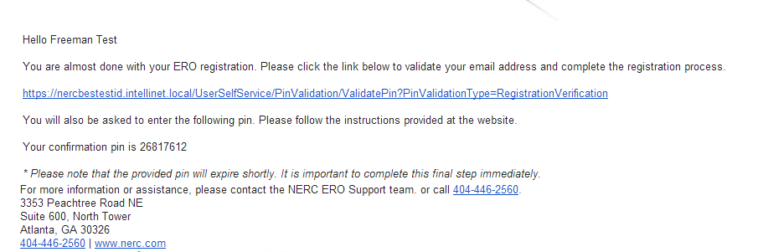
Verify Account – Part II
Verify Account – Part II
Upon successful verification, a verification email will be sent to the email account used to create your user account. Upon verification you will be able to access your account with preliminary permissions.
IMPORTANT: The activation email provided for validation expires after 10 minutes if not used.
Notes:
Speaker note: Must click on the link provided and use the confirmation pin provided within the 10 min. window

Slide 13
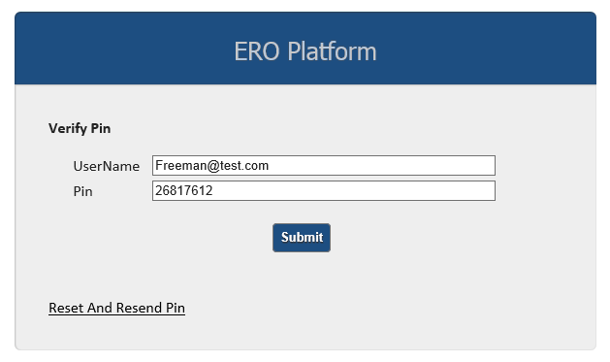
Verify Account – Part II
Verify Account – Part II
Enter your username and confirmation pin found in the system generated email.
SELECT Submit.
Upon verification you will be able to access your account with preliminary permissions.

Slide 14
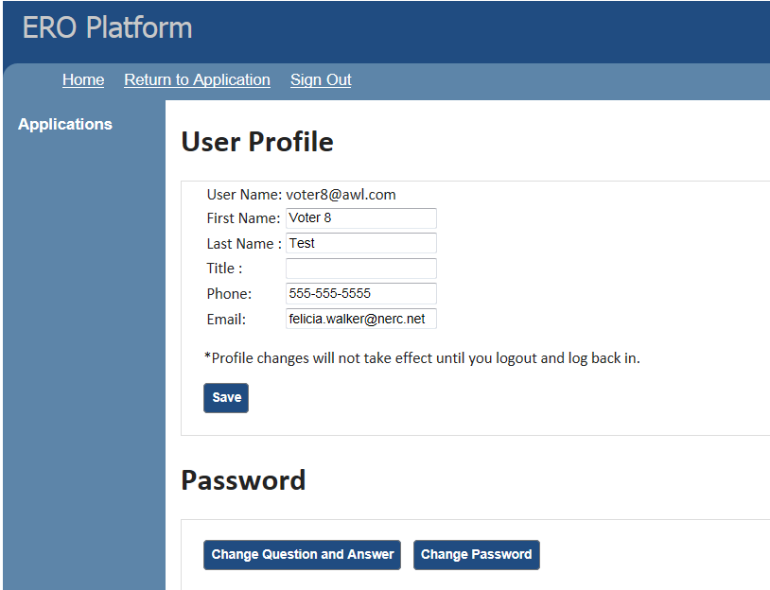

ERO Platform - Applications
ERO Platform – Select Application
SELECT the application that you wish to access or request additional permissions.
Notes:
Speaker Notes: As mentioned prior the activation provides only limited permissions. To gain additional permissions, individual must select each of the applications they wish to have permissions to and following the prompts to gain the additional permissions. Select the SBS link

Slide 15
Login/Register
User Dashboard:
After selecting SBS in ERO Platform
After you have selected SBS in the ERO Platform (see previous slide) the SBS Dashboard will be viewable.
Select Login and your User Name and Role will automatically display.
Notes:
Speaker Notes:

Slide 16
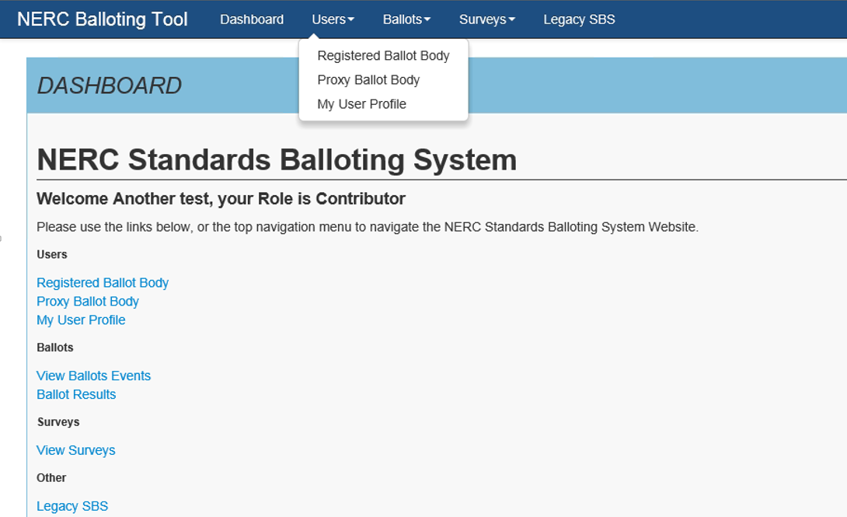
SBS Dashboard – Request Permissions
SBS Dashboard– Request Additional Permissions
After creating an account, logging in and navigating to the SBS Dashboard, your role will be set to default to Contributor role permissions.
SELECT the My User Profile link from the Dashboard or top navigation to request additional Standards Balloting System permissions.
Additional permissions must be requested prior to being granted access for the roles of Voter and Proxy.

Slide 17
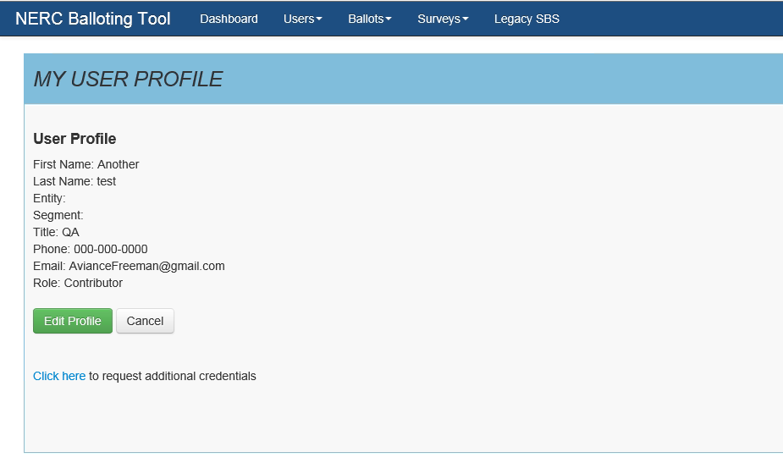
Request Permissions
Request Permissions
SELECT the Click here link to request additional credentials.

Slide 18
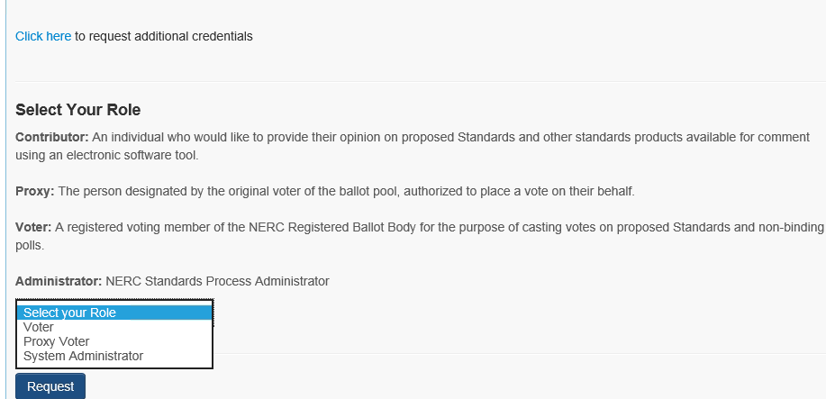
Request Permissions
Request permissions
After making the selection of your role (Voter, Proxy or Contributor) SELECT Request.
System Administrator – For NERC staff only

Slide 19
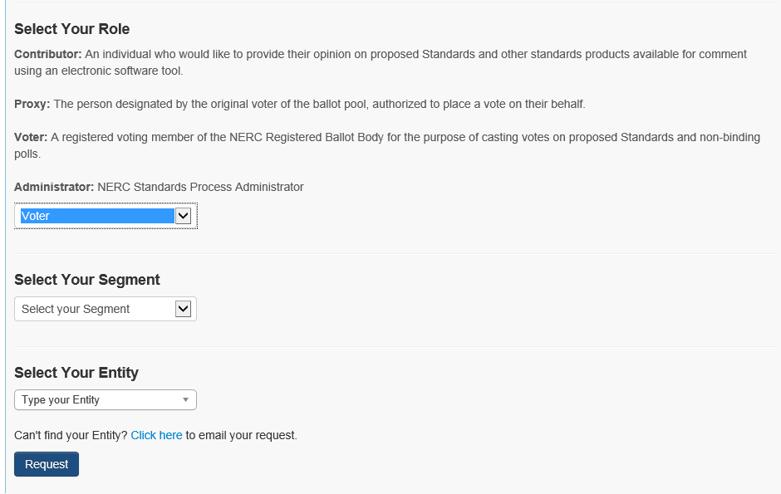

Request Permissions
ERO Platform – Select Application
Voter Request for Permissions:
Select Your Segment
Select Your Entity (Parent/Affiliate Listing)
Request permission
    If you can’t find your Entity name in the Entity listing, select the Click here link to send an email request to the Standards administrator to request to have your Entity name added.
Proxy Request for Permissions:
Request permission

Slide 20
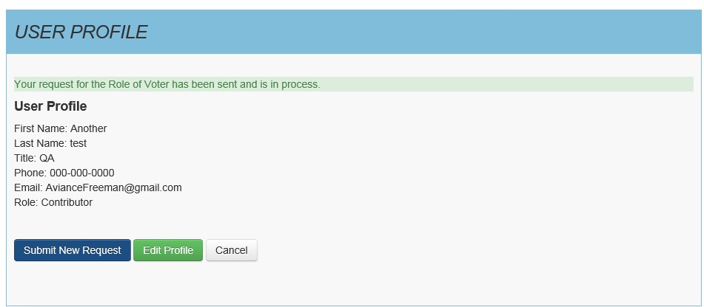
Request Permissions
Vetting Request Pending
Voter and Proxy requests requires further vetting by NERC Standards staff.
    Within three business days, you will receive notification approving or denying your request to join the Registered Ballot Body.
    During the initial heavy volume of registrations, it may take up to six business days to receive notification.
Notes:
Trainers note: If there is a denial, will there be an explanation of denial? IF denied, will they be a process to reapply?

Slide 21
ERO Platform Validation

Slide 22
Validation Process
Scenarios that require the validation process:
Initial validation
Subsequent validations when users log in
  User changes their user name
  Every 180 days
    Validation will be required via a password change
    Use the Reset Password feature

Slide 23
Validation Emails
Validation emails come from DoNotReply@nerc.net – Please validate your NERC ERO Account Information
You should receive the validation email within a couple of minutes
If you did not receive the validation email, check ‘spam’ or ‘junk’ folders
If validation email is not in ‘spam’ or ‘junk’ folders - check with your IT department to verify if the email is blocked
If your IT department did not block the validation email contact ballotadmin@nerc.net

Slide 24
Standards Information
Standards
  Program News
    Weekly Standards Bulletin
Standards Processes Manual
Resources
SBS questions/feedback - ballotadmin@nerc.net

