Slide 1
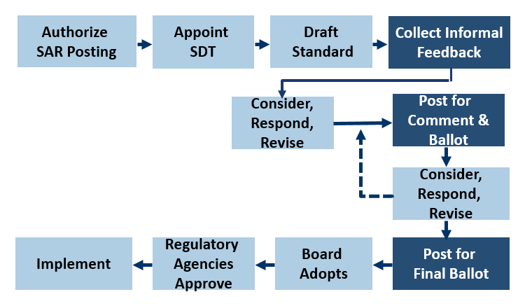
Current Standards Process

Slide 2
Special Rule for Regulatory Directives - Section 321
Standard submitted to Board that does not meet regulatory directives
Remand to Standards Committee with instructions
Standard passes final ballot
Standard development process reinitiates by either:
Reinitiating project with existing SAR
Developing new SAR and project to address directives

Slide 3
Section 321
Standard fails in ballots to timely meet regulatory directives
Remand to Standards Committee with instructions
Convene technical conference
Prepare memo
Re-ballot standard within 45 days
Adopt standard and file
Yes
Achieve 66 2/3% approval?
No
Issue notice of intent to adopt, solicit comment
Convene technical conference (optional)
Considering the record and input:
Adopt
Adopt as draft and file as non-enforceable
Remand for further work
Yes
Achieve 60% approval?
No
Direct SC and/or NERC staff to draft
Convene technical conference (optional)
Considering the record and input:
Adopt
Adopt as draft and file as non-enforceable
Remand for further work

Slide 4
Proposed Section 322
Board sees inadequate or no progress on urgent reliability issue
Board issues notice; opens comment period
Board considers input
Board issues directive
SDT acts on directive (feedback)

Slide 5
Potential Section 322 Initiation

Slide 6
Potential Section 322 Initiation

Slide 7
Special Rule for Regulatory Directives - Section 321
Standard submitted to Board that does not meet regulatory or Board directives
Remand to Standards Committee with instructions
Standard passes final ballot
Standard development process reinitiates by either:
Reinitiating project with existing SAR
Developing new SAR and project to address directives

Slide 8
Proposed Revised Section 321
Standard fails in ballots to timely meet regulatory or Board directives
Remand to Standards Committee with instructions
Convene technical conference
Prepare memo
Re-ballot standard within 45 days
Adopt standard and file
Yes
Achieve 66 2/3% approval?
No
Issue notice of intent to adopt
Convene technical conference (optional)
Considering the record and input
Adopt
Adopt as draft and file as non-enforceable (regulatory directives only)
Remand for further work
Yes
Achieve 60% approval?
No
Direct SC and/or NERC staff to draft
Convene technical conference (optional)
Considering the record and input
Adopt
Adopt as draft and file as non-enforceable (regulatory directives only)
Remand for further work

