Slide 1
Standards Balloting and
Commenting System (SBS) Tutorial
July 2016

Slide 2
Standards Balloting and Commenting System (SBS) Tutorial Topics
Registering in the SBS/Registered Ballot Body (RBB)
Features of the SBS
Navigation
Register/Requesting Additional Permissions
Voter
Proxy
Contributor
Cast a Vote
Take Survey (Commenting)

Slide 3
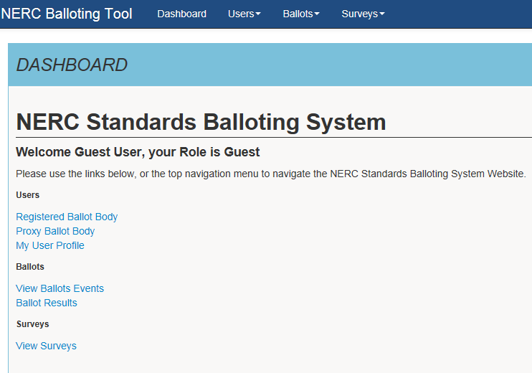
Navigation
Navigating the SBS
Dashboard View
The dashboard makes it easy to get to the functions used every day. The drop-down menus at the top and the links on the left-hand side of the dashboard gain access the different pages within the site.
Guest users have view/read-only access to the RBB, open and upcoming ballots and surveys (comment periods) without logging into the application using ERO Platform credentials.

Slide 4
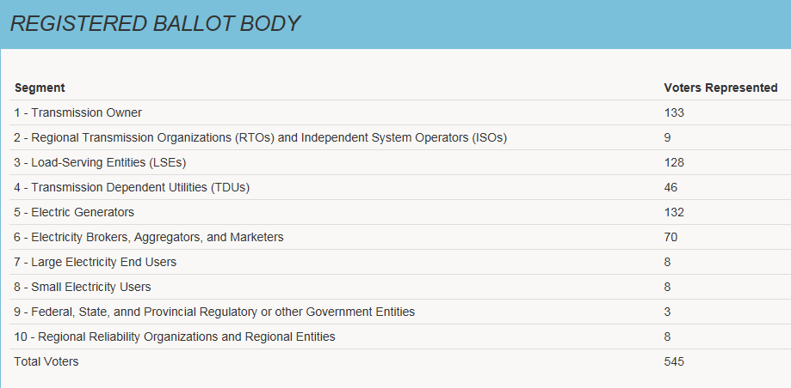
Viewing the RBB
The top section displays a summary/count (by segment) of the approved RBB members
The bottom section displays details for each member such as status (approved/pending), segment, entity name, first and last name

Slide 5
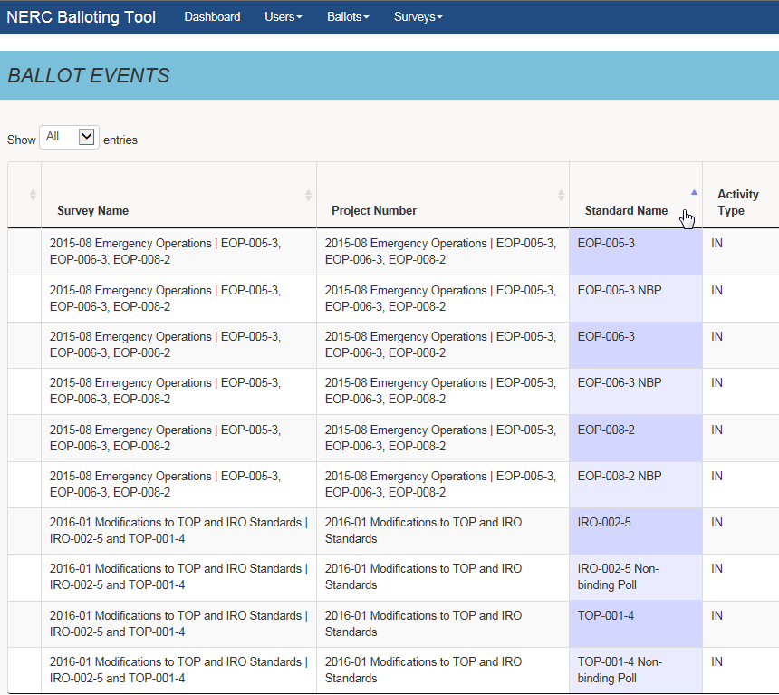
Sort Feature
To sort in ascending or descending order, select the column header
The rows within the sorted column will display in alternate shades to indicate the column header has been sorted
Notes:
Speaker Note: Each of the header columns can be sorted by clicking on the small arrow to the right of each one in the column. Once sorted, the column will display the alternate shades as an indication to which column has been sorted.

Slide 6
Search Feature
Use the search feature to locate specific information such as survey, project number/name, standards number/name activity type, ballot type (displayed here) dates, etc.
Notes:
Speaker Notes: Any text information located under each of the columns is searchable information. Once search is completed, all items in the system matching your specific search criteria will be ranked at the very top of the screen.

Slide 7
View Ballot Results
Published ballot results are displayed on the Ballot Results page. Select the “Results” link to access the results for a specific ballot.
Notes:
Speaker Notes: To view the “results” click on the one you would like details on and the link will display additional information on the specific ballot.

Slide 8
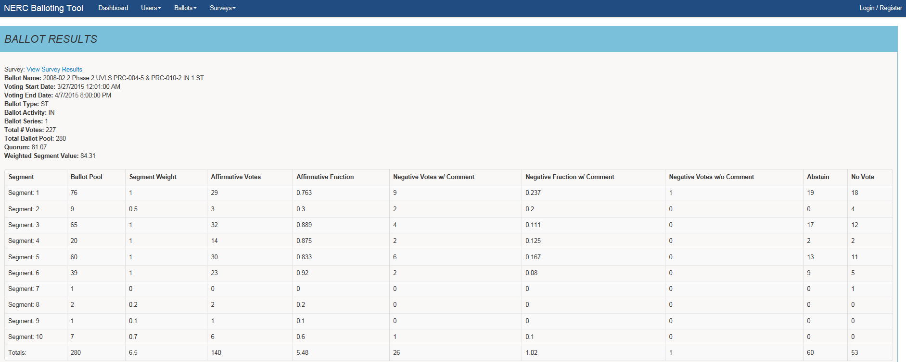
Ballot Results Summary
The top section displays the ballot results and a summary count of ballot pool members and votes by segment
Notes:
Speaker Notes: Detailed information will be displayed on the drill down to include: Ballot name, Voting dates(start and end) Ballot: type, activity and series, and total votes: The middle section of the Ballot results display the specifics of the ballot based on segments can be researched.

Slide 9
Ballot Result Details
The bottom section displays the individual ballot details. Use the search and sort features by segment, entity name, voter name, designated proxy name, ballot cast and NERC memo. All entries will show by default. This can be modified to show 10, 25, 50, or 100 entries at a time.
Notes:
Speaker Notes: In the bottom section of the results, in this section the search and sort features can be utilized. Sort based on the clicking the arrows to the right of each column or Search by typing in the information located under each column.
Remember: Once a section has been sorted, you will see the alternating shades in the column to indicate that you sort was successful.

Slide 10
RBB Registration

Slide 11
SBS Roles and Permissions
Role | ERO Platform Account Required | Additional Permissions Required?
Guest/ Anonymous User | No | No
Contributor | Yes | No
Proxy | Yes | Yes
Voter | Yes | Yes
Certain roles require an ERO Platform account and additional permissions to perform standards balloting activities
Guest: Has view/read-only access to SBS dashboard links
Contributor: Has the ability to provide comments on proposed standards and other items posted for comment
Proxy: Authorized to provide comments on proposed standards (and other items posted for comment) and cast a vote on behalf of the RBB member
Voter: Member of the RBB authorized to cast votes and comment on proposed standards and other items posted for comment
Notes:
Speaker Notes: Ensure individuals know what SBS (Standards Balloting System) and RBB (Registered Ballot Body) mean during the discussion

Slide 12
Registration (New ERO Platform Account)
From the SBS dashboard, select “Register” in the upper right-hand corner to create a new ERO Platform account
Notes:
Speaker Notes:

Slide 13
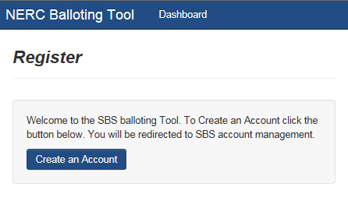
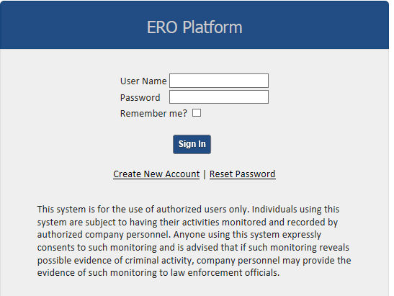
Create an Account
Select “Create an Account”
Select “Create New Account”

Slide 14
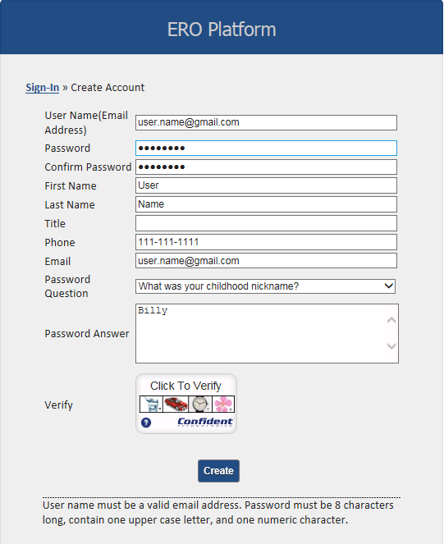
Create an Account
Complete all of the required fields
User Name – enter valid business email address
Password – must be 8 characters long and contain one upper case letter, and one numeric character
Confirm Password – re-enter password
First Name – enter first name
Last Name – enter last name
Title (Optional) – enter title
Phone – enter phone number
Email – enter valid business email address
Password Question – select a security question
Password Answer – enter password answer
Notes:
Speaker Notes: All fields are required when creating a new user account. If any fields are omitted, you will get an error message and will not be allowed to proceed.

Slide 15
Verify Account – Part I
Select the “Verify” icon and several images display. Select the correct image of each description as instructed until all three pictures have been verified then select “Create”.
Notes:
Speaker Note: Final phase of creating an account you will have to complete the additional security layer that has been added to the system. Once you select the verify icon, you will have several images to choose from in the icon box. The system will direct you to identify three objects in order based on specific questions pertaining to the pictures. Once you have completed three of the identifications successfully, we will now be able to select the activated “create” button.

Slide 16
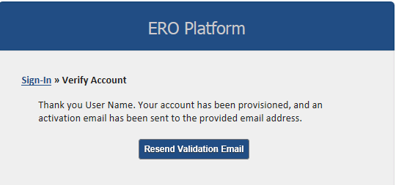
Verify Account – Part II
Verify Account – Part II
Upon successful captcha verification, an email will be sent to the email address used to create the account.
IMPORTANT: The activation email provided for validation expires after 10 minutes if not used.
If expired, SELECT the “Resend Validation Email” to have an additional activation email sent.
Notes:
Speaker Note: Stress the 10 minutes security feature. Most passwords will remain active for much longer so the individual understands the urgency of activating the account immediately.

Slide 17
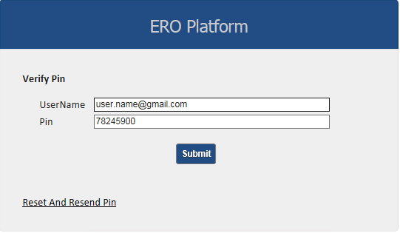
Verify Account – Part II
A message will be sent to the user’s email address.
Enter the username associated with the account and confirmation pin found in the system generated email then select “Submit”.
Upon verification, Contributor access will be granted.
Notes:
Speaker note: Must click on the link provided and use the confirmation pin provided within the 10 min. window

Slide 18
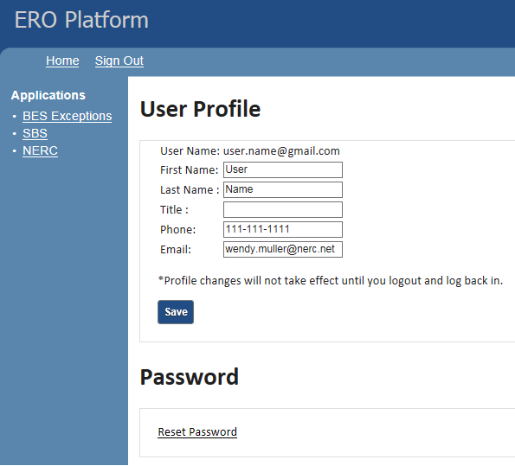
ERO Platform – Application
Select “SBS” to access the current account
Notes:
Speaker Notes: As mentioned prior the activation provides only limited permissions. To gain additional permissions, individual must select each of the applications they wish to have permissions to and following the prompts to gain the additional permissions. Select the SBS link

Slide 19
Accessing Current Role
In most cases, each time a user logs into the system, the user’s role will be listed as “Guest” even though the user have contributor, proxy, or voter credentials. By selecting “Login” again at the top, right of the screen, the user’s name and current role will display.

Slide 20
Requesting Voter/Proxy Permissions
Select “My User Profile” from the “Users” drop-down menu or from the menu list on the left of the screen.

Slide 21
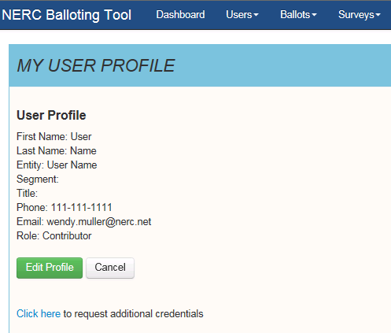
Requesting Voter/Proxy Permissions
Select the “Click here” link to request additional credentials

Slide 22
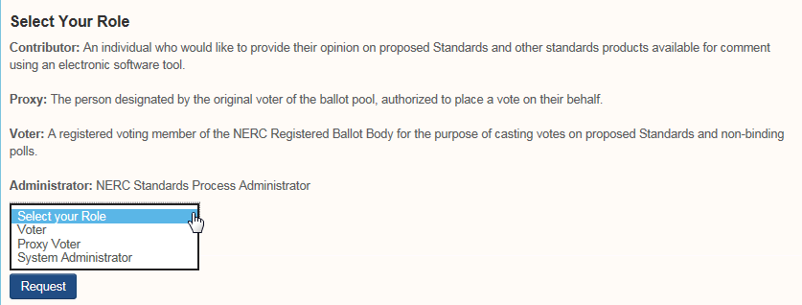
Requesting Voter/Proxy Permissions
Select voter or proxy voter role.
Note: The System Administrator role is for NERC use only.

Slide 23
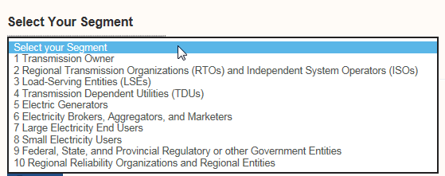
Requesting Voter/Proxy Permissions
Select segment and entity (parent/affiliate listing)
If an Entity name is missing from the drop down list, select the “Click here” link to send an email to the Standards Administrator requesting the Entity name is added to the system.

Slide 24
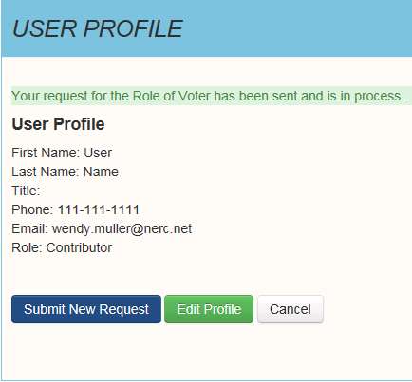
Request Permissions
Voter and Proxy registrations require vetting by NERC Standards and Legal staff. Within 10 days of receiving all required documentation, NERC Standards staff will communicate the registration status to the applicant.
Notes:
Trainers note: If there is a denial, will there be an explanation of denial? IF denied, will they be a process to reapply?

Slide 25
Voter

Slide 26
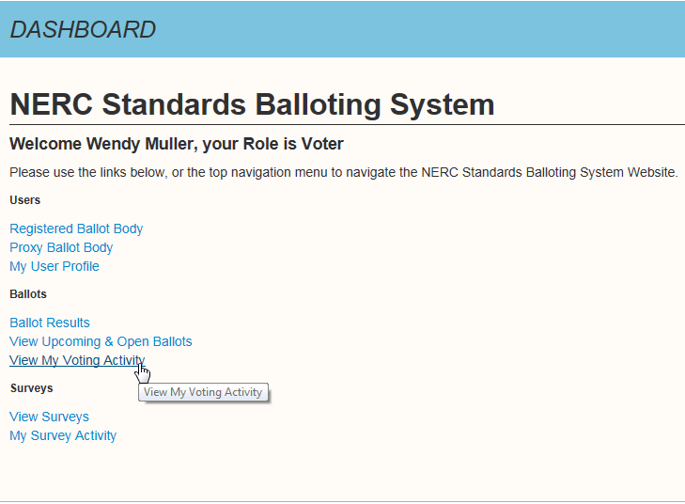
Voter Dashboard
The Dashboard provides convenient access to the SBS functions. Use the links on the left-hand side of the Dashboard or the top navigation drop-down menus to access different pages within the site.
Select My Voting Activity from the Ballots drop down at the top of the screen or from the left navigation list to access open ballot pools and ballots.
Notes:
Speaker Note: When a voter creates and account, they should follow the process outlined previously.

Slide 27
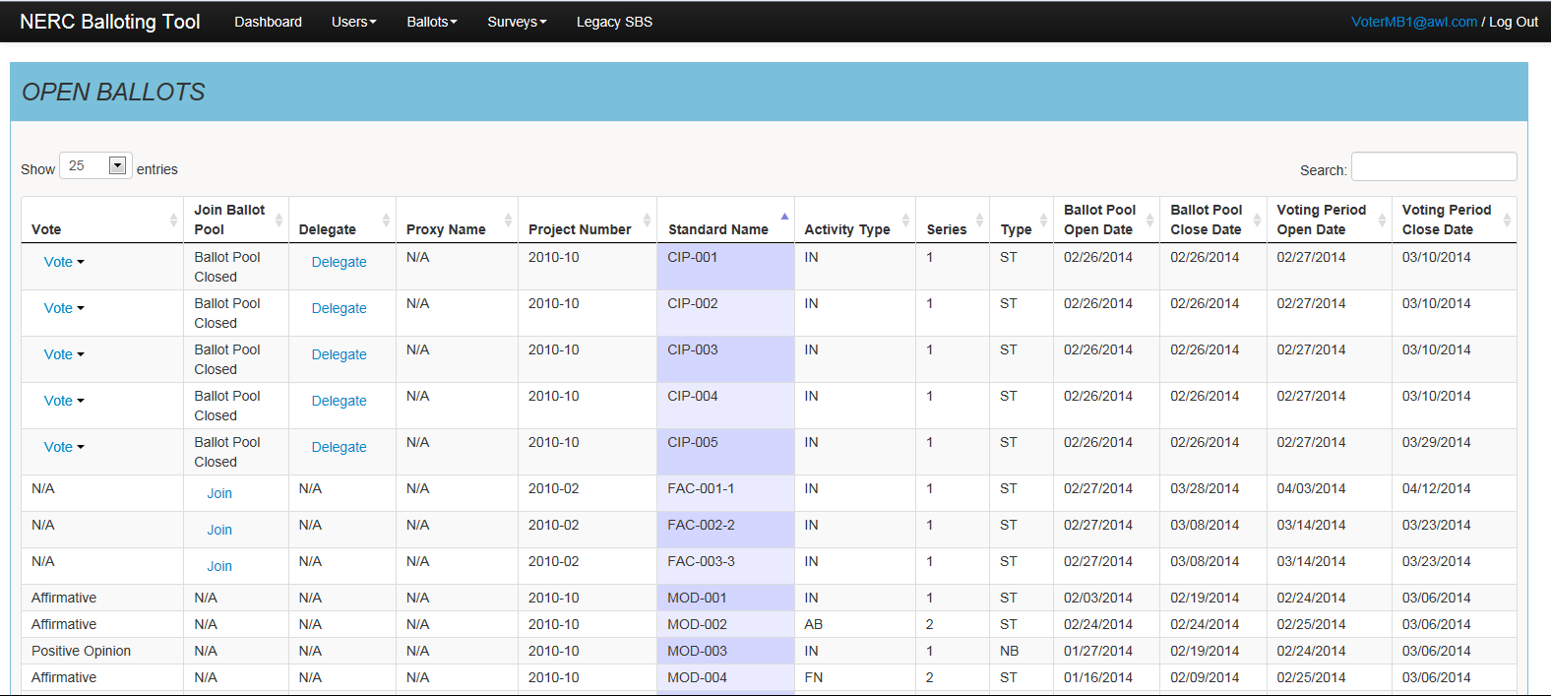
My Voting Activity
My Voting Activity brings the user to the Open Ballots screen. Here the column headers can be sorted by Segment, Entity Name, Voter Name, Designated Proxy Name, Ballot Cast and NERC Memo. All entries are shown by default, but there is an option to modify the screen to show 10, 25, 50 or 100 entries at a time.
Notes:
Speaker Notes: Once in the screen you can see all of the various aspects of the ballots. Each column is sortable and will display alternating colors once it has been sorted.

Slide 28
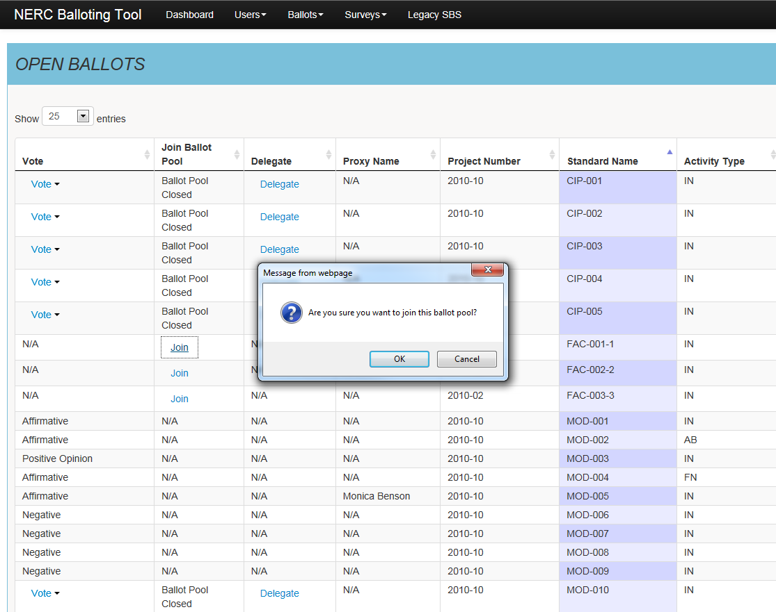
My Voting Activity
Join open ballot pools by selecting the “Join” hyperlink. The link will refresh to display “Withdraw” to indicate that you have successfully joined the ballot pool.
Notes:
Speaker Note:

Slide 29
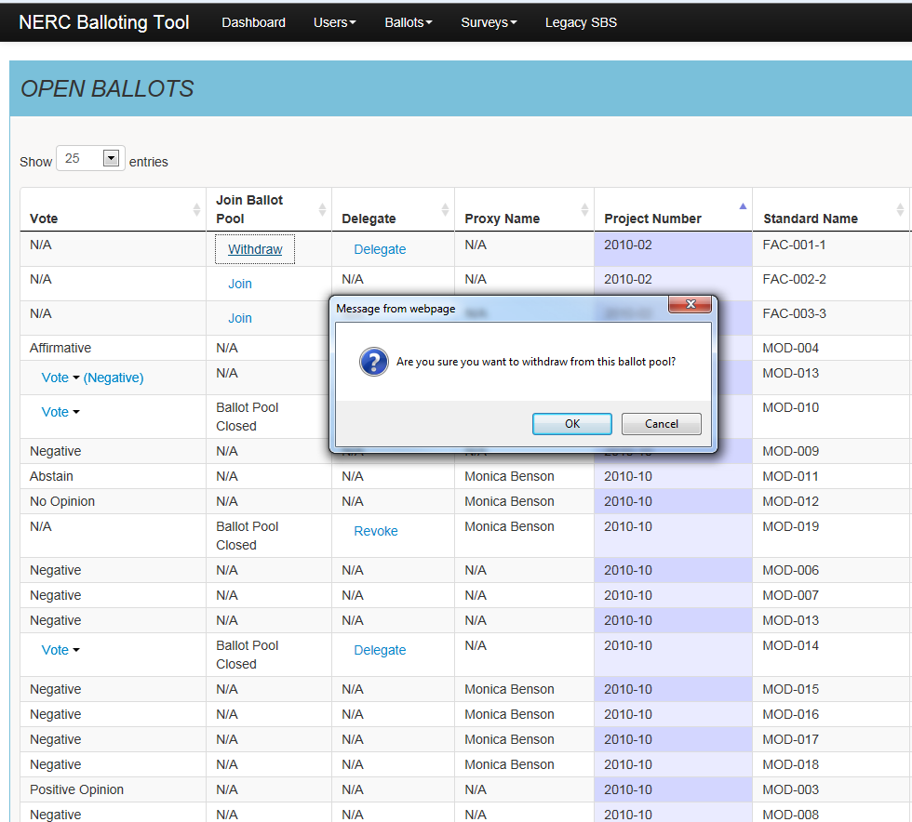
My Voting Activity
To withdraw from open ballot pools, select the link and confirm the request to “Withdraw”. The link will refresh to display “Join” to indicate that you have successfully withdrawn from the ballot pool.
A user can join (and withdraw) from the ballot pool for the duration the ballot pools are open.

Slide 30
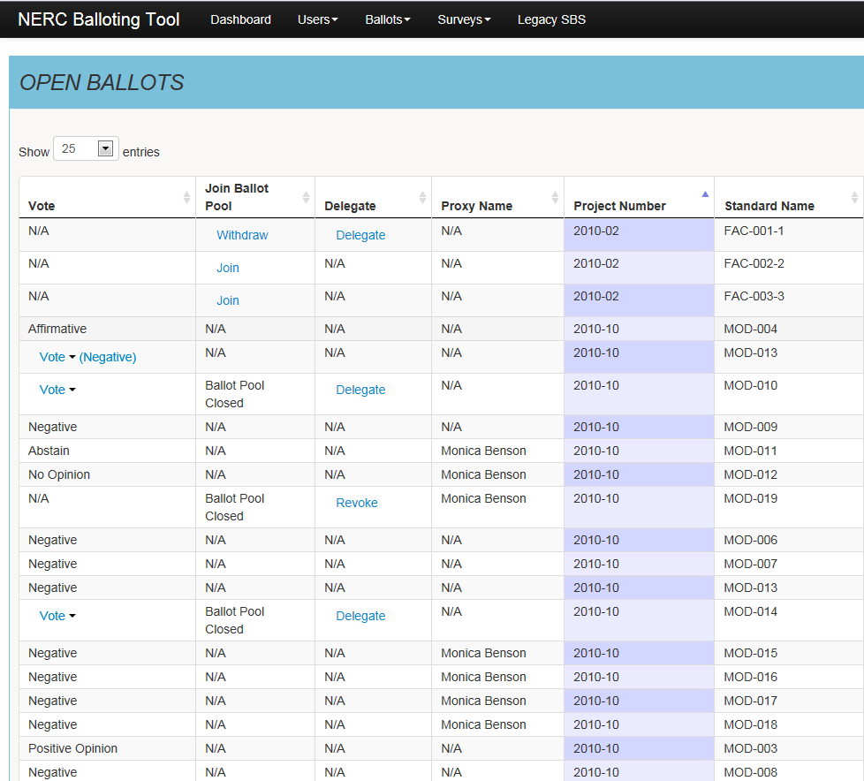
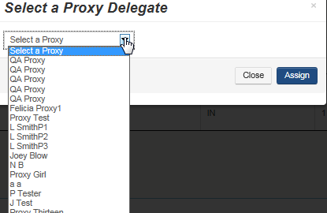
My Voting Activity
Delegate voting rights to a Proxy by clicking the “Delegate” link and selecting a name from the drop-down list of approved Proxies. After confirming the request to delegate, the link will refresh to display the Proxy’s name and with options to revoke Proxy.
Until a vote has been cast, Proxy voting rights can be delegated during the open ballot pool and voting period.
An email notification will be generated to the Proxy
notifying them that voting rights have been
Delegated.

Slide 31
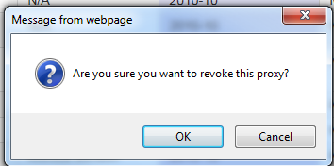
My Voting Activity
Voting rights of a Proxy can be revoked by selecting the link and confirming the request to “revoke this proxy.” The link will refresh to display options to delegate another Proxy.
Until a vote has been cast, Proxy voting rights can be revoked during the open ballot pool and voting period.
An email notification will be generated to the Proxy
notifying them that voting rights have been
revoked.
Notes:
Speaker Notes: Are there any typical reasons Proxy rights maybe revoked?

Slide 32
Proxy

Slide 33
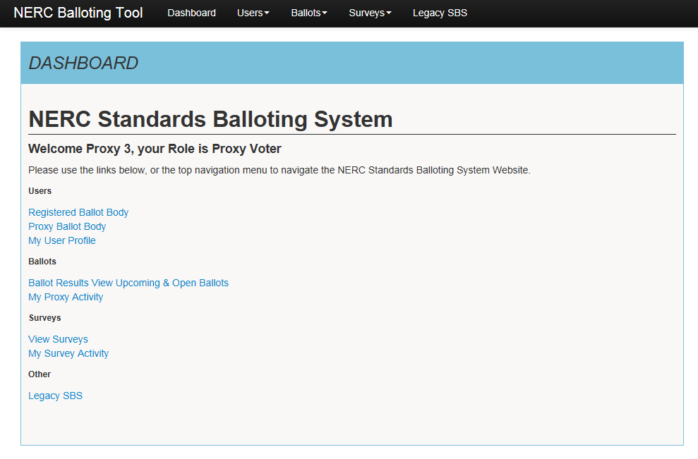
Proxy Dashboard
The Dashboard makes it easy to get to the functions you use every day. Use the links to the left-hand side of the Dashboard or the top navigation to access the different pages within the site.
A Proxy must create an account and request additional permissions prior to performing activities. After vetting has been completed, the Proxy will receive email notification confirming voter access has been granted.
Notes:
Speaker Notes: Follow the steps to request additional permissions as outlined previously

Slide 34
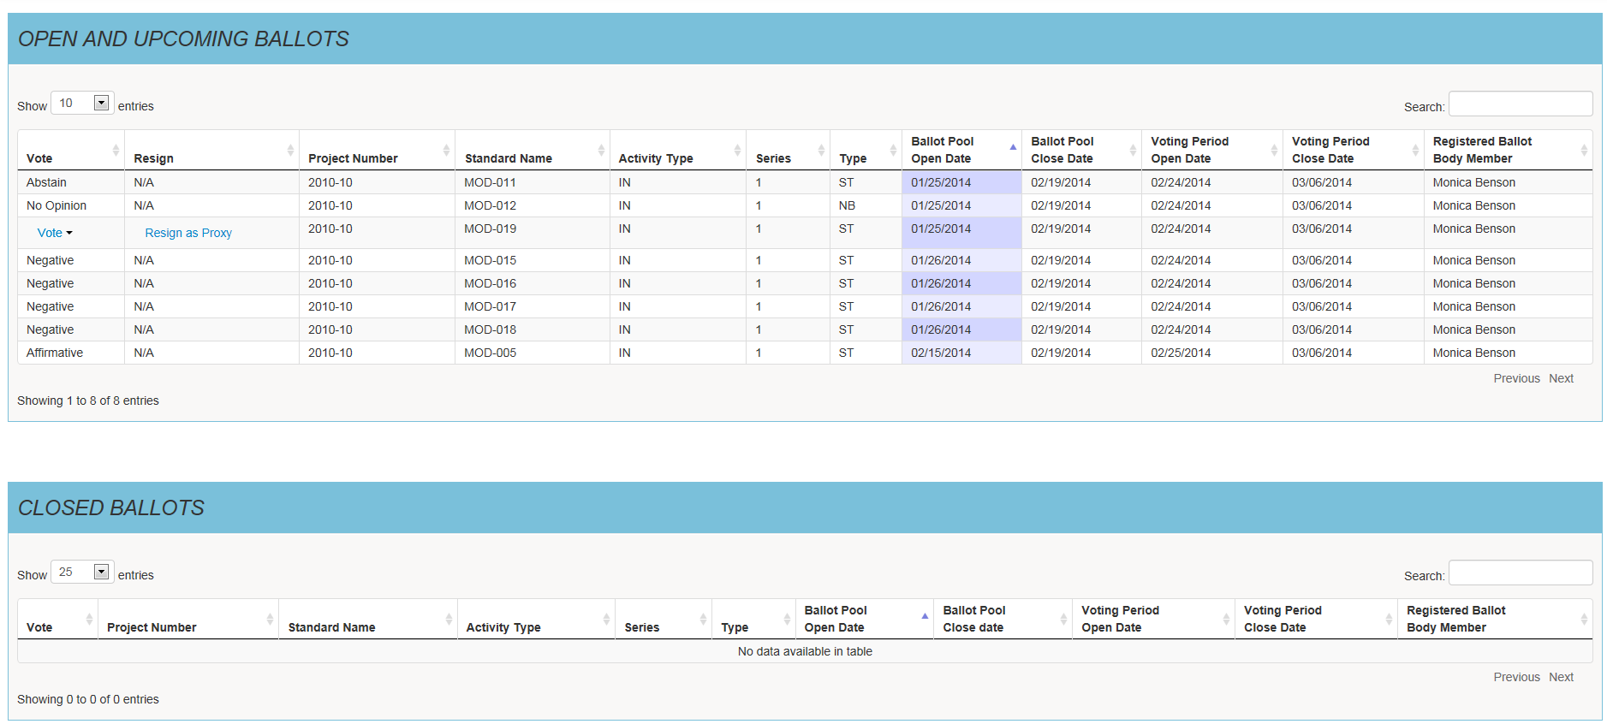
My Proxy Activity
My Proxy Activity – Open and Upcoming Ballots
The My Proxy Activity provides a listing of upcoming and open ballots that you have been delegated voting rights. You may search or sort the column headers by Segment, Entity Name, Voter Name, Designated Proxy Name, Ballot Cast and NERC Memo. All entries will show - you can modify your settings to show 25, 50 or 100 entries at time.

Slide 35
My Proxy Activity
My Proxy Activity – View Closed Ballots
Provides a listing of closed ballots that you have been delegated voting rights for. The system will display up to 2 years of Proxy voting history.

Slide 36
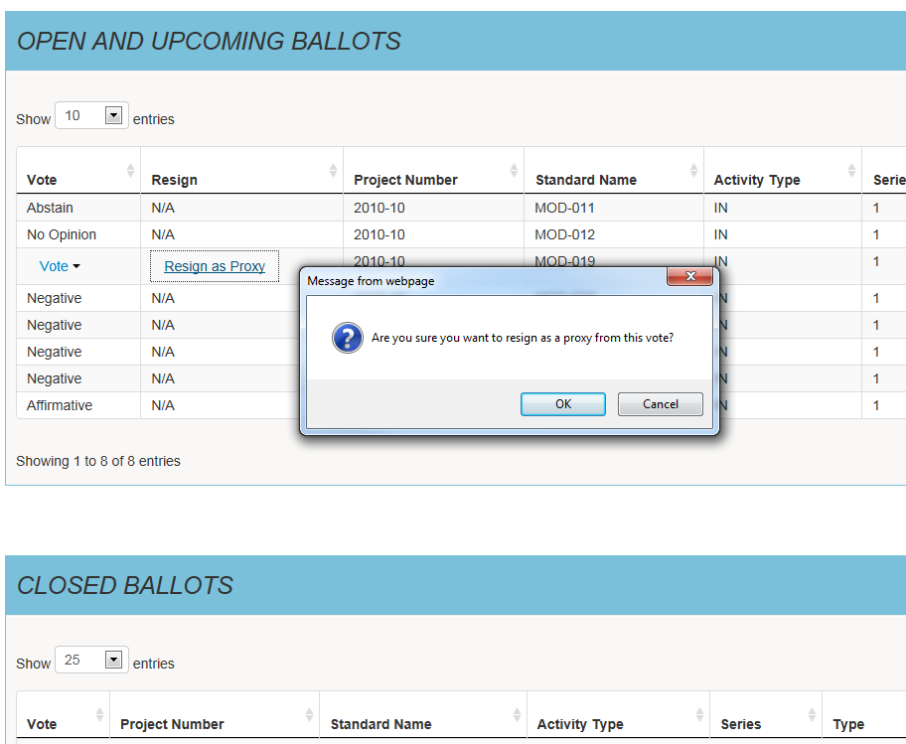
My Proxy Activity
My Proxy Activity – Resign as Proxy
You may resign Proxy voting rights back to the voter during the open ballot pool or open voting period by selecting the “RESIGN AS PROXY” hyperlink. Upon confirmation, the page will refresh to remove the ballot from the Proxy listing.
An email notification will be generated to the Voter alerting them to resume voting activities or delegate voting rights to another Proxy.
Notes:
Speaker Notes: What are some typical scenarios that may lead to a person resigning as a Proxy?

Slide 37
Contributor

Slide 38
Contributor Dashboard
Contributor Dashboard
Navigating SBS – Contributor
The Dashboard makes it easy to get to the functions you use every day. Use the links to the left-hand side of the Dashboard or the top navigation to access the different pages within the site.
A Contributor must create an account prior to performing SBS activities. Contributor permissions are automatically granted. Further vetting is not required.
Notes:
Reviewer Note: Is there a special process in which a contributor creates and account prior to SBS activities?
Speaker Note: If yes, Discuss that process, is it similar to the other roles gaining access?

Slide 39
Cast a Vote

Slide 40
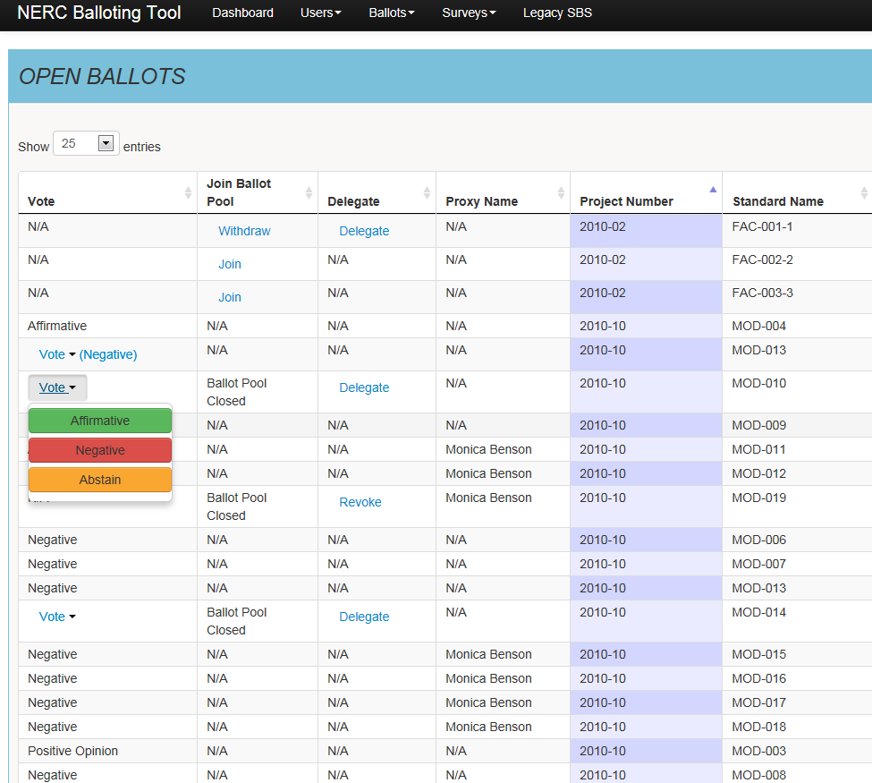
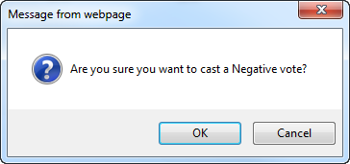
Cast a Vote
Cast a Vote
From the “My Voting Activity” or “My Proxy Activity” page you may cast a vote by selecting the “Vote” link. Upon confirming your vote the link will refresh to display the text of vote that was cast.
You may only cast a vote during the open
voting period for ballot pools that you
joined.
Prior to confirming your vote, you may
CANCEL the transaction to change your vote.
You will again be prompted to confirm
your vote in order to have your vote counted.

Slide 41
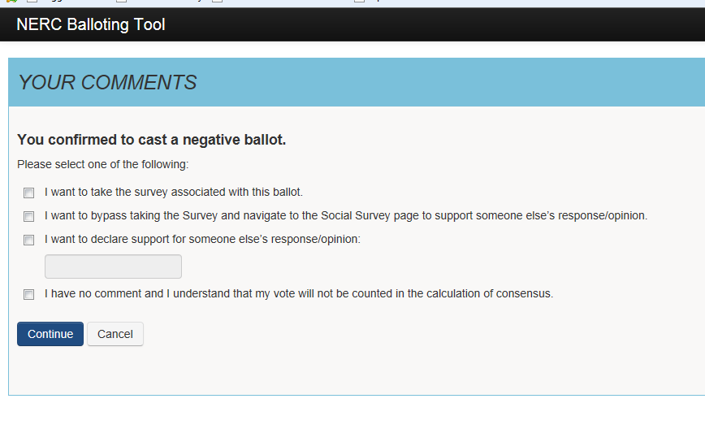
Negative Vote – Options To Take Survey
Cast a Negative Vote and Take Survey
When casting a negative vote for Initial and Additional Ballot types, the system will verify if a comment was submitted or if there was support for someone else’s response. When the system verifies that no comment was submitted, the system will display options to the user to submit a comment.
You may select one of the options
listed in the confirmation window
after casting a negative vote during
the open voting period.
Notes:
Speaker Notes: Comments count, approximately how many comments are read from vote. Share with the participants

Slide 42
Negative Vote with Options to Take Survey
1
User is directed to the Take Survey page to post a comment.
User is permitted to access Social Survey to post an opinion to someone else’s response.
User is permitted to enter the name of the Individual or Group for comments they support
User acknowledges a comment will not be submitted and is directed back to the My Voting/Proxy Activity page.*
2
1
3
2
3
4
4
* Negative votes without associated comments will not count in the total vote calculation.
Notes:
Speaker Notes: Comments count, approximately how many comments are read from vote. Share with the participants

Slide 43
Take Survey (Commenting)

Slide 44
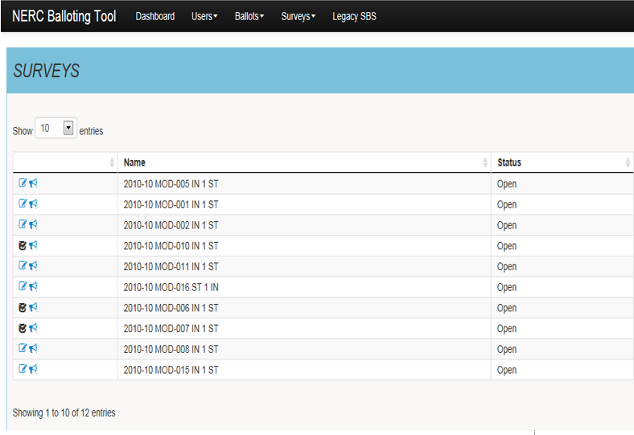
View Surveys
View Surveys
Navigate to the View Surveys page from the Dashboard or top navigation.
SELECT the Paper/Pen icon to Take the Survey. You must be logged into the system to post a comment.
SELECT the Horn icon to view Social Survey. You can view comments real-time and provide support or disagreement via a thumbs up or down.
Notes:
Reviewer Note: What is the significance of the third icon? Looks like a bold check mark, is that an indication that comments have been added?
Speaker Note: Make reference to the third symbol indicating what it is

Slide 45
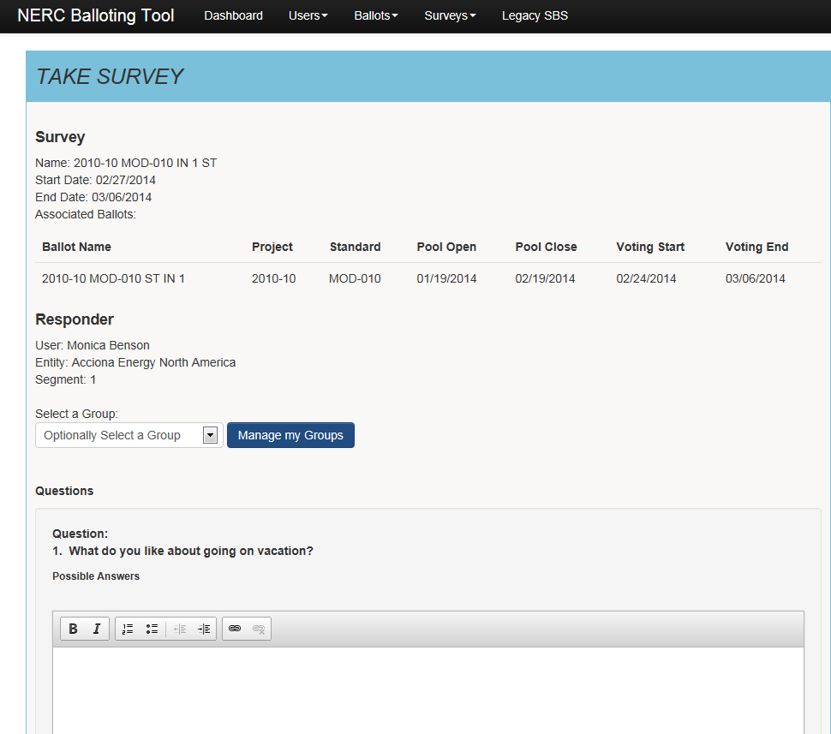
Take Survey (Commenting) – Create a Group
Create Group
You may participate in Taking a Survey (submit comments) as an individual or as a group.
In order to select an existing group to Take a Survey you must first create a group.

Slide 46
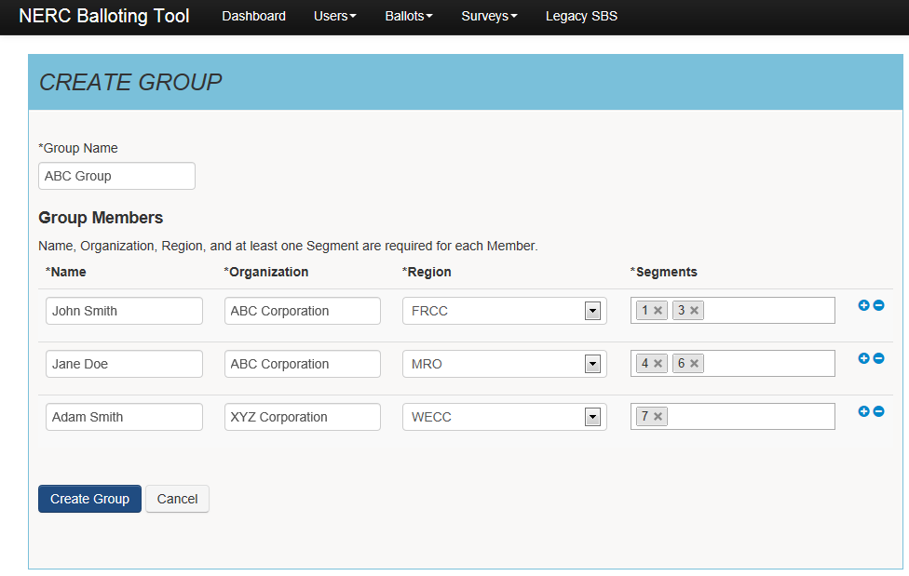
Create a Group
Create Group
1
Enter a unique group name
Enter the first and last name of each group member
Enter the name of the organization
SELECT applicable Region *N/A is an acceptable value
SELECT one or more segments in which the organization operates *N/A is an acceptable value
SELECT “Create Group”
2
1
3
4
2
3
4
5
5
6
6
Notes:
Speaker Notes: All fields are required.

Slide 47
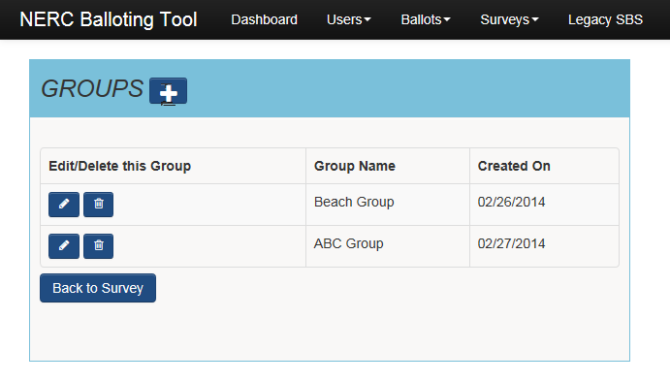
Manage Group
Modify Groups or Members
SELECT the Plus icon to create a new group
SELECT the Pencil icon to Edit Group Members (Add/Delete Members)
SELECT the Trash icon to Delete a Group

Slide 48
Take Survey (Commenting) – Existing Group
Select Existing Group
You may select an existing group to Take a Survey.

Slide 49
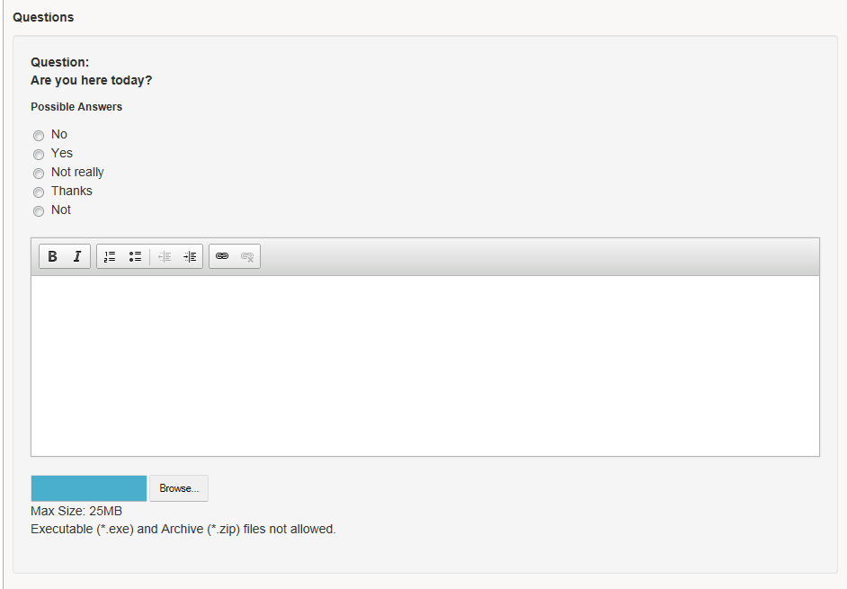
Take Survey (Commenting) – Upload Document
Upload a Document
SELECT browse to upload and attach a document to support your response to a Survey question.
Up to 25MB file max size.
Executable (*exe) and Archive
(*zip) files are not allowed.

Slide 50
Take Survey (Commenting) – Format Text
Format Text
Use the text editor to format text.
Ex. Bold, italics, numbering, bullets, indent, decrease indent.
Copy paste text into the text field by performing the Ctrl + C to copy information from source document. Press Ctrl + V to paste information into text field box

Slide 51
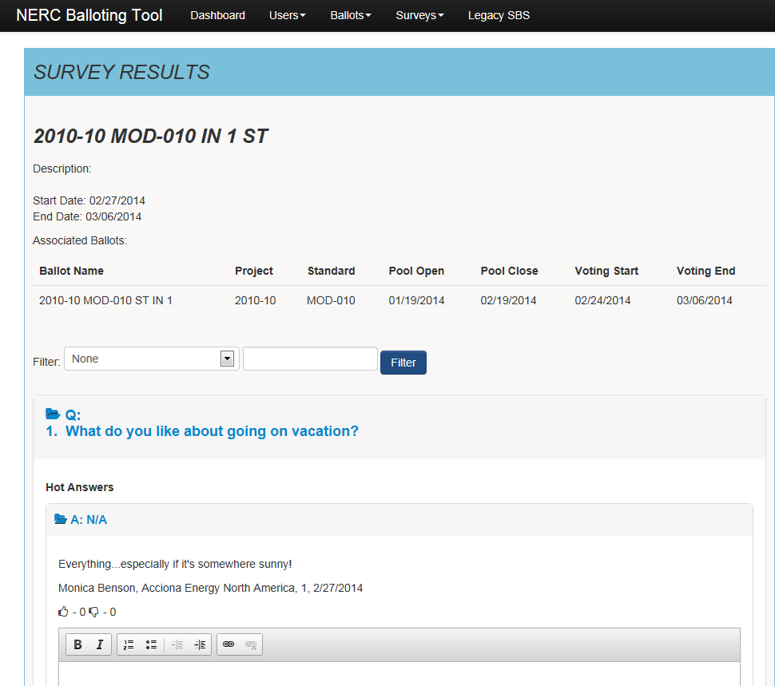
Social Survey – View Comments Real-Time
View comments submitted by other entities real-time.
SELECT thumbs up or thumbs down icons to show support or disagreement for a comment submitted by another entity.

Slide 52
Standards Information
Standards
Program News
Weekly Standards Bulletin
Standards Processes Manual
Resources
SBS questions/feedback - ballotadmin@nerc.net

