Slide 1
Project 2020-05 Modifications to FAC-001 and FAC-002
December 14, 2021

Slide 2
Agenda
Administrative
Review NERC Antitrust Compliance Guidelines and Public Announcement
Agenda
SAR
Standard Updates
Next Steps
Questions and Answers

Slide 3
NERC Antitrust
It is NERC’s policy and practice to obey the antitrust laws and to
avoid all conduct that unreasonably restrains competition. This
policy requires the avoidance of any conduct that violates, or
that might appear to violate, the antitrust laws. Among other
things, the antitrust laws forbid any agreement between or
among competitors regarding prices, availability of service,
product design, terms of sale, division of markets, allocation of
customers or any other activity that unreasonably restrains
competition. It is the responsibility of every NERC participant
and employee who may in any way affect NERC’s compliance
with the antitrust laws to carry out this commitment.

Slide 4
NERC Public Disclaimer
Participants are reminded that this meeting is public. Notice of the meeting was widely distributed. Participants should keep in mind that the audience may include members of the press and representatives of various governmental authorities, in addition to the expected participation by industry stakeholders.

Slide 5
SAR
Initiated by IRPT Review of NERC Reliability Standards White Paper
Ambiguity exists in the term “materially modified” and which entity is responsible for making such a determination
Notes:
Mohit

Slide 6
Project Goals
Consider ways to clarify which entity is responsible for making the determination of what is considered to be a material modification to a Facility.
Consider requiring Facility owners to notify affected entities when making a material modification to a Facility.
Consider changing the term “materially modifying” to avoid confusion with similar terminology that is used for a different purpose in the FERC Open Access Transmission Tariff.
Consider other manners in which to clarify existing requirements to ensure new or materially modified Facilities on the Bulk Electric System (BES) are adequately accounted for to ensure reliability.
Notes:
Mohit

Slide 7
Standards Updates
FAC-001-4
Conforming changes in requirements R3-R4 to remove term “materially modified” and use “qualified change”
FAC-002-4
Proposed new requirement R6
Introduces “qualified change”
Assigns Planning Coordinator (PC) as entity responsible for defining
Conforming changes in requirements R1-R4 to remove term “materially modified” and use “qualified change”
Notes:
Delyn - Speak verbally that “quailed change” is not a defined term. Team did not define the term as it is a unique definition based on area and entity that the PC is qualified to make.

Slide 8
FAC-002-4
Proposed new Requirement R6
Notes:
Delyn

Slide 9
Supplemental Documents
Implementation plan:
Proposing 12-months
Technical Rationale:
Includes old Guideline and Technical Basis from FAC-001-2 Requirements R3 and R4
Discussion on new Requirement R6 of FAC-002-4
Explanation of why PC is appropriate entity
Notes:
Delyn

Slide 10
Posting
Initial Draft of FAC-001-4 and FAC-002-4
Clean and redline versions
Implementation Plan
Technical Rationale
Posting Dates
Ballot Pools formed through January 10, 2022 (extended due to holidays)
Initial ballot voting January 21– 31, 2022
Project Page
Notes:
Alison

Slide 11
Next Steps
Respond to Comments
Team Meetings starting in February
Projected Second Posting in April/May
Point of Contact
Alison Oswald, Senior Standards Developer
Alison.oswald@nerc.net or call 404-446-9668
Webinar Posting
48-72 hours
Standards Bulletin

Slide 12
Q & A Objectives
Informal Discussion
Via the Q&A feature
Chat only goes to the host, not panelists
Respond to stakeholder questions
Other
Some questions may require future team consideration
Please reference slide number, standard section, etc., if applicable
Team will address as many questions as possible
Webinar and chat comments are not a part of the official project record
Questions regarding compliance with existing Reliability Standards should be directed to ERO Enterprise compliance staff, not the Standard Drafting Team

Slide 13
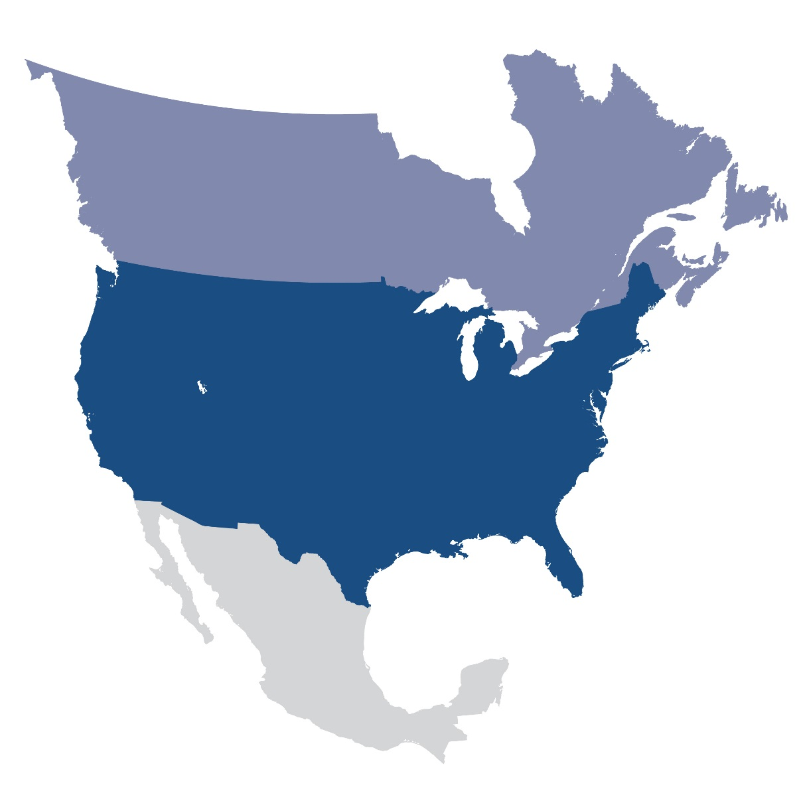
Questions and Answers

Slide 14
Webinar has ended – Thank You

